Slide 1


Online direct import of specimen records from iDigBio infrastructure into taxonomic manuscripts
Lyubomir Penev , Viktor Senderov
Institute for Biodiversity and Ecosystem Research, Bulgarian Academy of Sciences, Sofia, Bulgaria & Pensoft Publishers penev@pensoft.net
Pensoft & iDigBio Webinar, 16 June 2015

Slide 2
Poll results

Slide 3
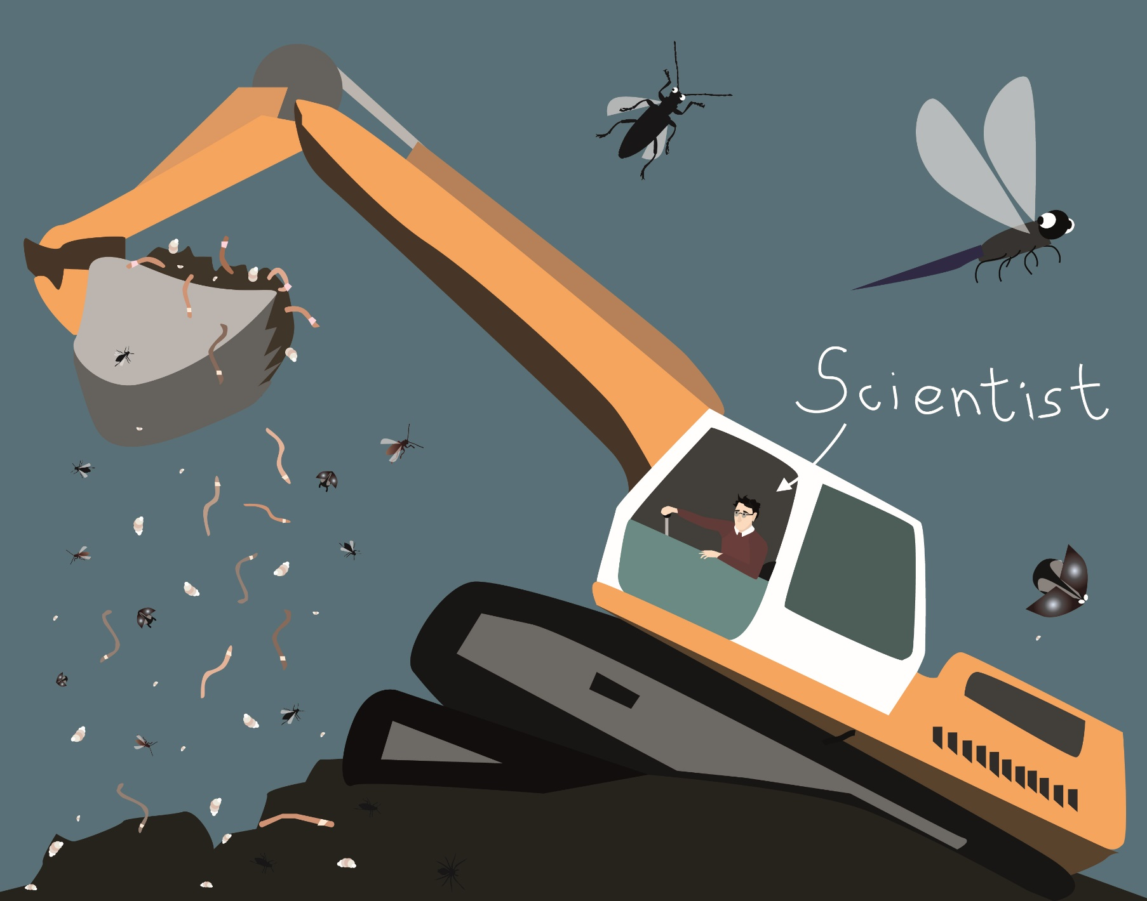
Data deluge: We now sample more data than we can digest (analyze, publish & use)
Drawings: slavenapeneva.com

Slide 4
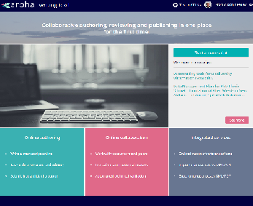
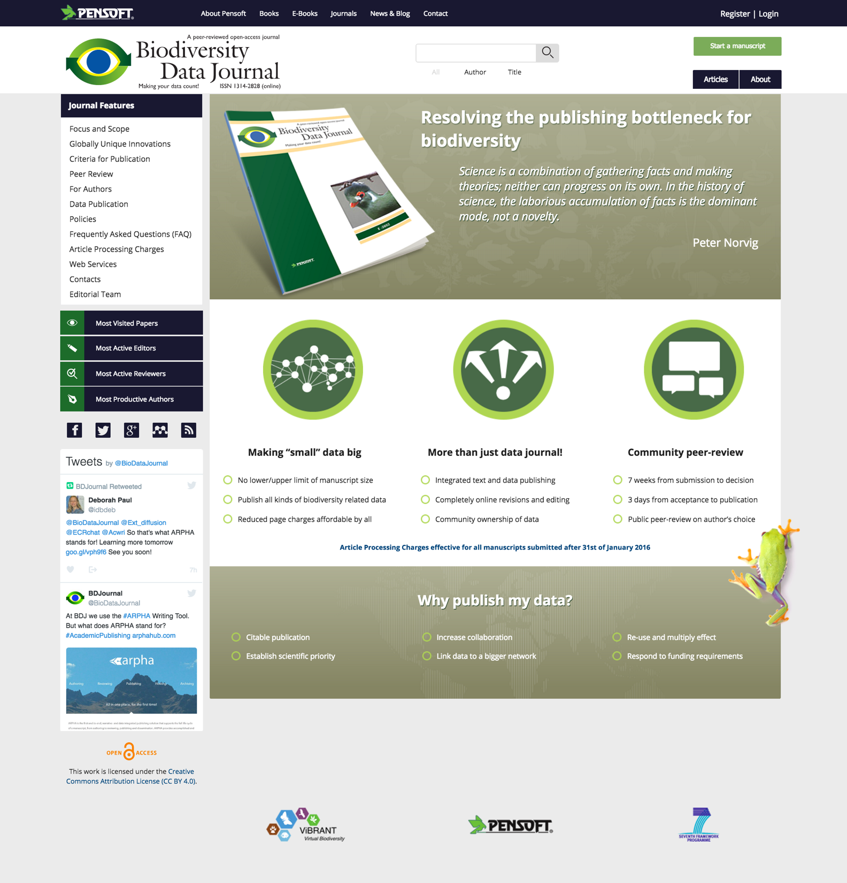
ARPHA Writing Tool & Biodiversity Data Journal facilitate data publishing & re-use
Next-Gen taxonomy requires Next-Gen publishing
+
Data import
Authoring
Peer-review
Publication
Dissemination
All within a single online collaborative platform!

Slide 5
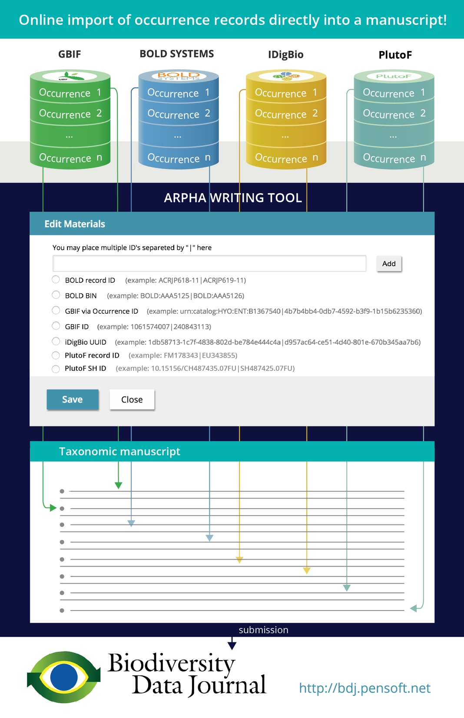
This fictionalized workflow presents the flow of information content about biodiversity specimens or biodiversity occurrences from the data portals GBIF, BOLD Systems, iDigBio, and PlutoF, through user-interface elements in ARPHA to textualized content in a research manuscript in Biodiversity Data Journal.
In the next few slides, we illustrate the workflow using the example of iDigBio.

Slide 6
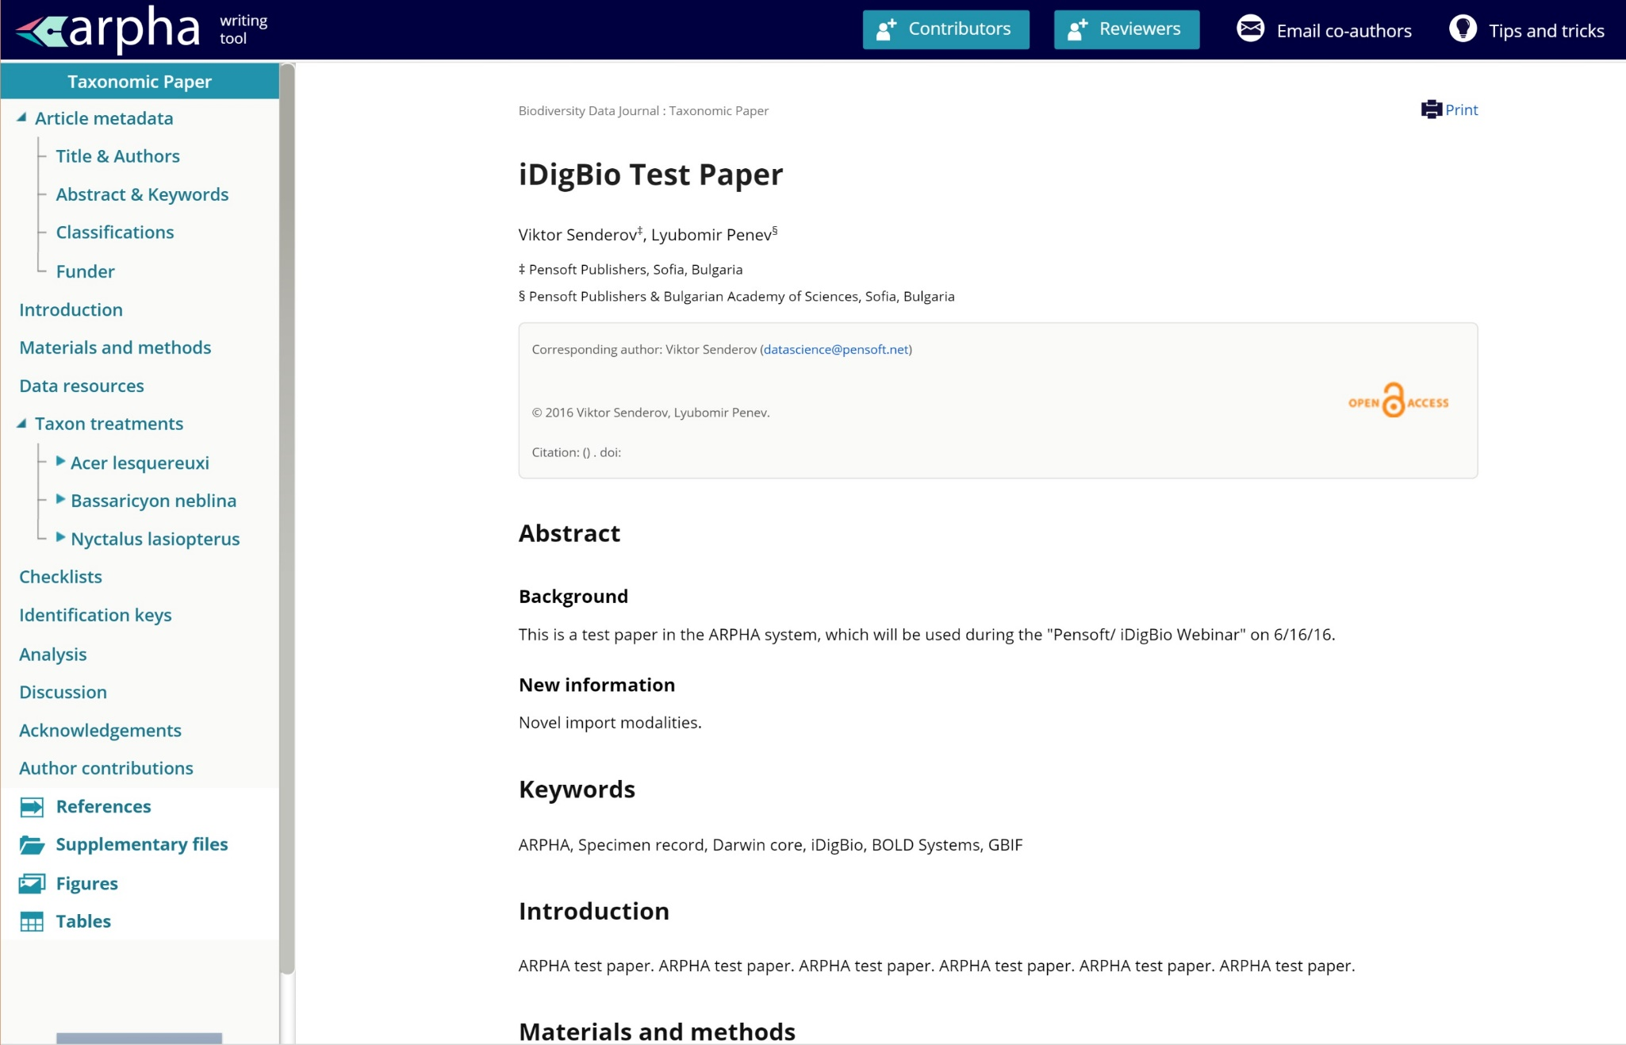
Step 1:
Step 1: Start a taxonomic manuscript in ARPHA, and open a taxon treatment

Slide 7
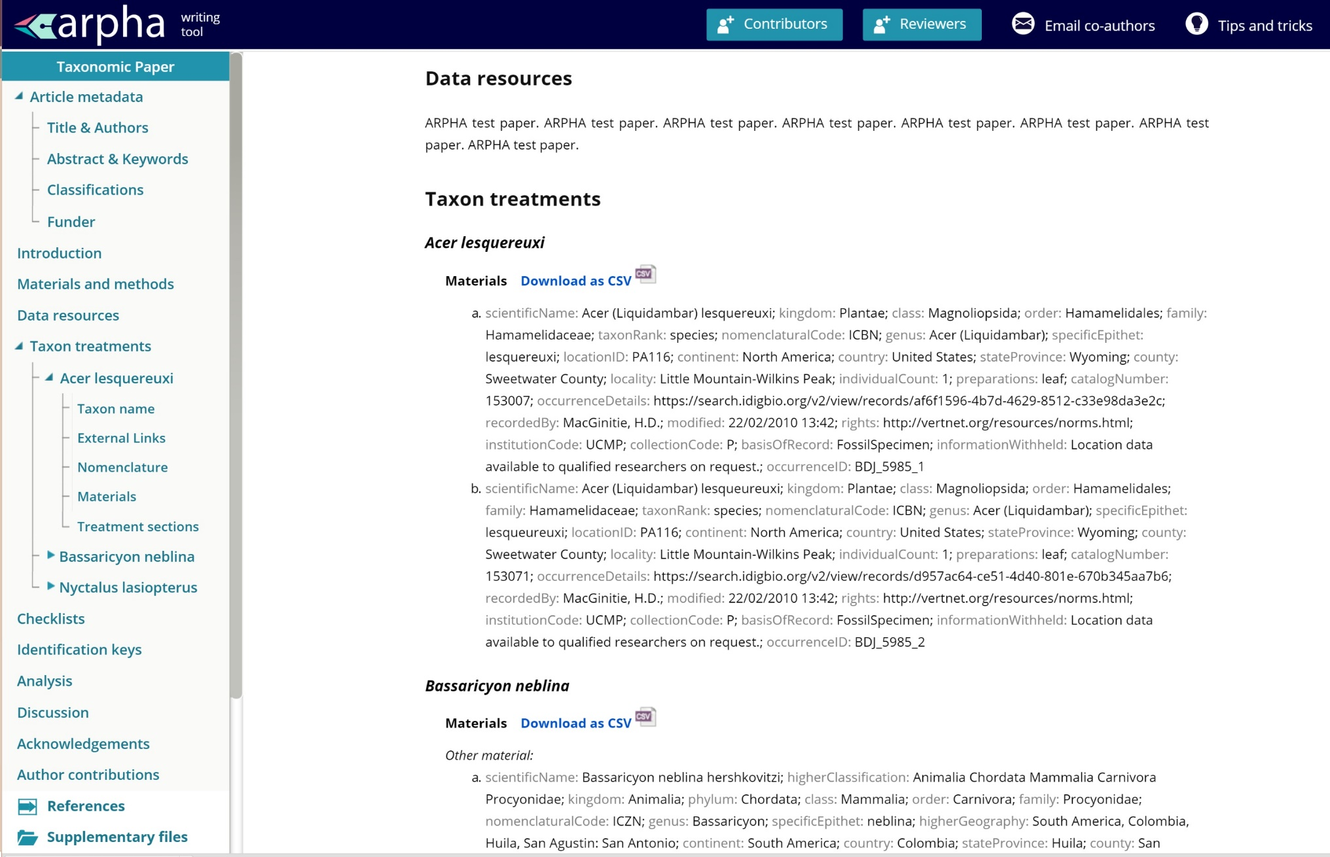
Step 1:
Step 2a: Click at the Materials section within the treatment

Slide 8
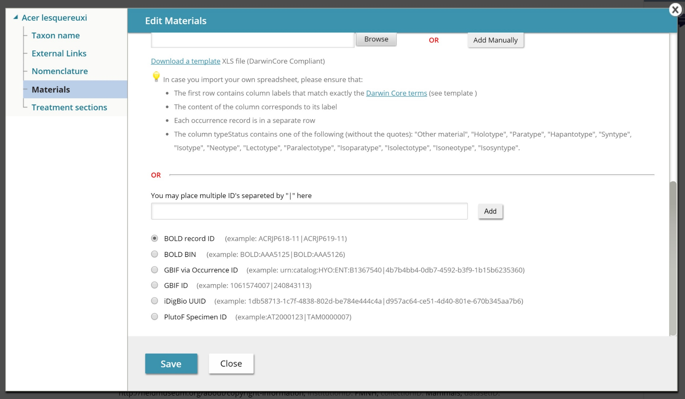
Step 2b: Three ways to import specimen occurrence records into a manuscript

Slide 9
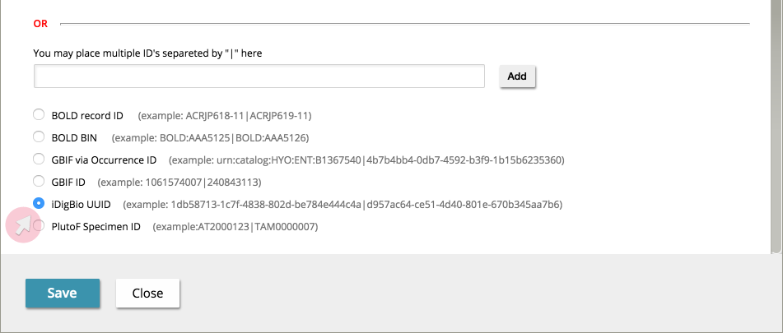
Step 3: Import from iDigBio (or GBIF, or BOLD, or PlutoF) using record ID(s)

Slide 10
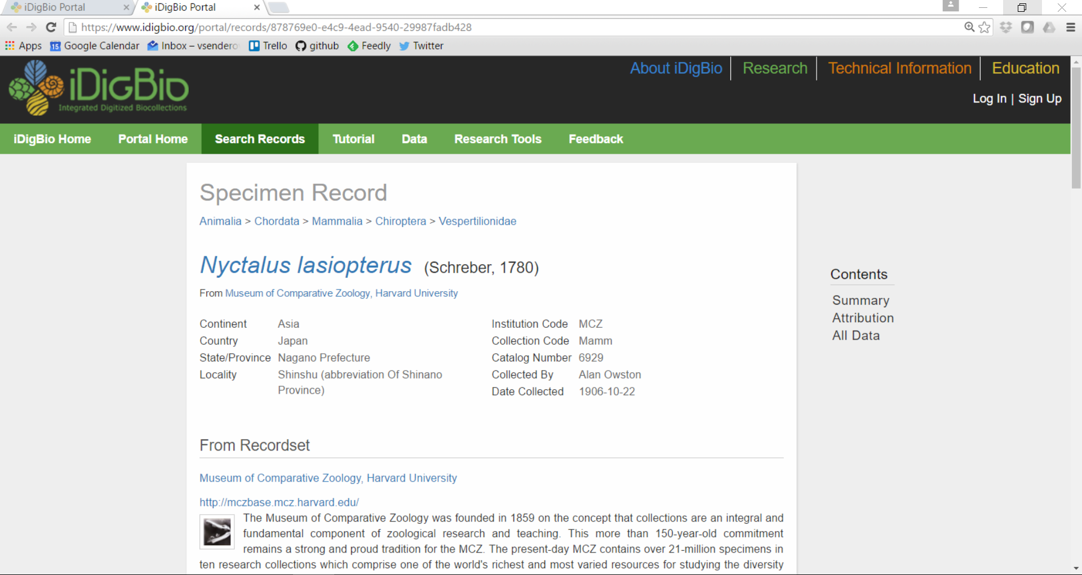
Where to take record IDs from iDigBio?

Slide 11
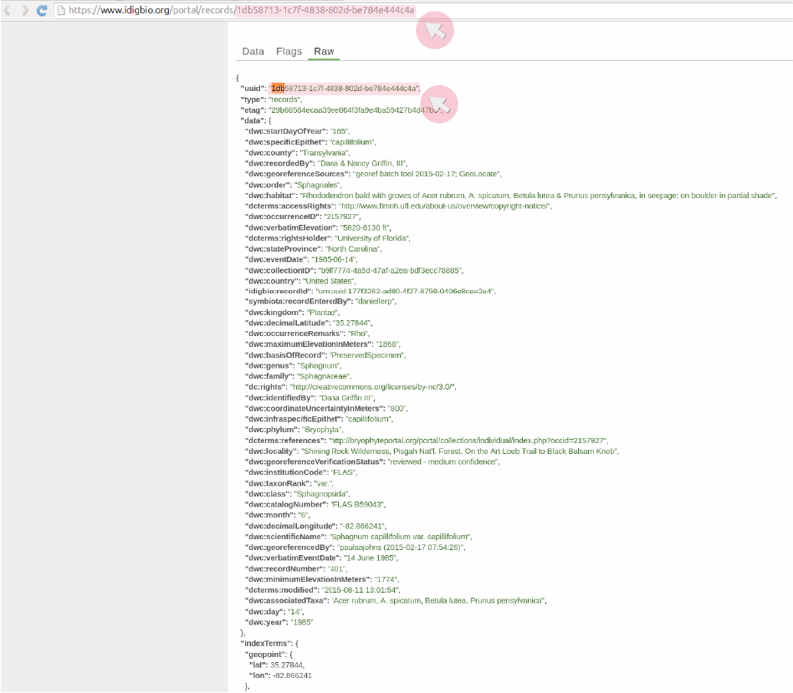
Where to take record IDs from iDigBio?

Slide 12
WHY import & publish specimen records in this way?
Avoid re-typing errors and save time
Tracking (provenance) information is saved in occurrenceDetails
Mobilization, peer-review and publication of small data
Data downloadable anytime as CSV file
Machine-readable and harvestable (from the XML version of the published article)
Automatically exported in Darwin Core Archive
Automatically exported to and indexed by GBIF on the day of the publication
Interoperable in DarwinCore standard
Re-usable (new opportunities for collaboration)
Increase discoverability, visibility, and citation of authors’ work

Slide 13
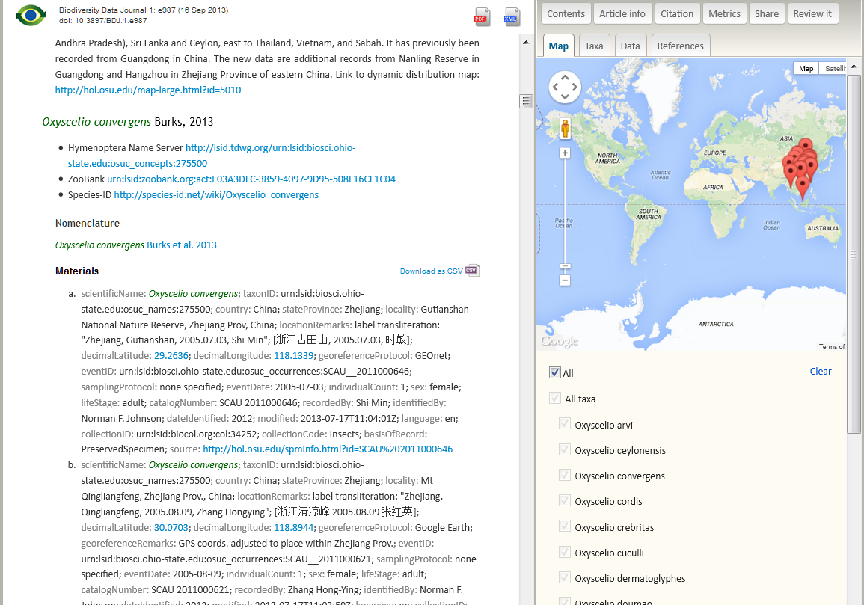
This is how data look like in the published paper

Slide 14
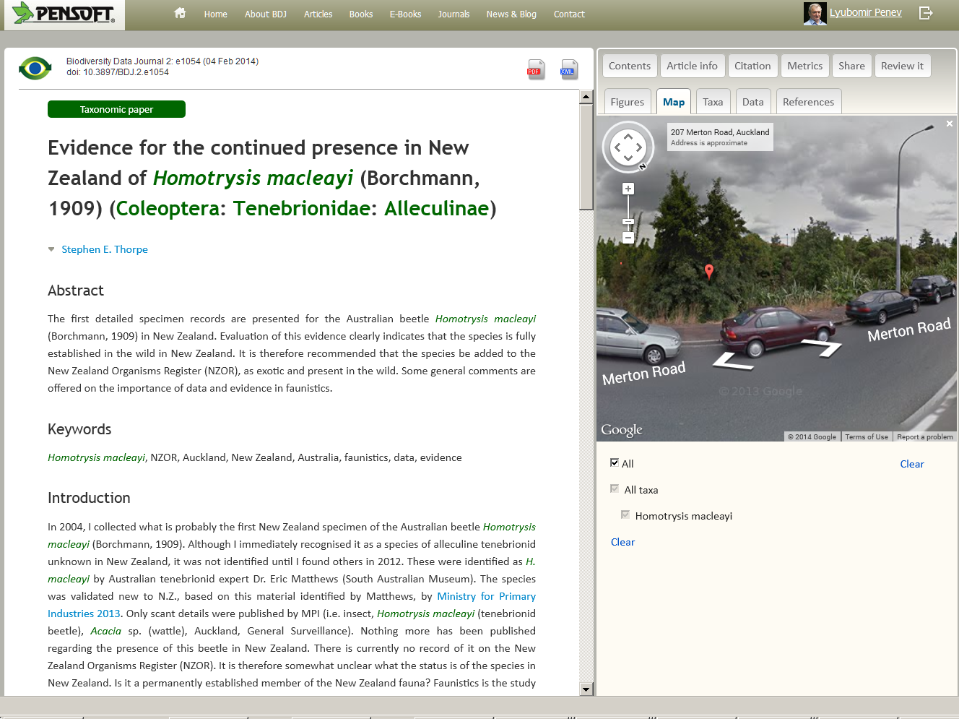
Mapping & visualization

Slide 15
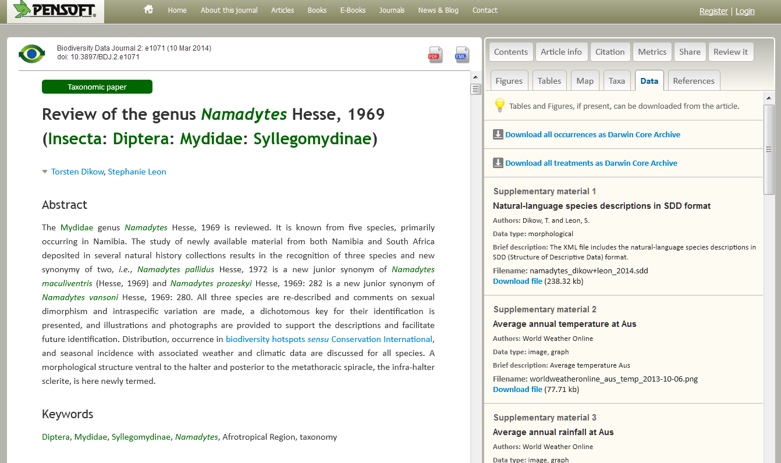


Easy export, harvesting & re-use

Slide 16
Live demo

Slide 17
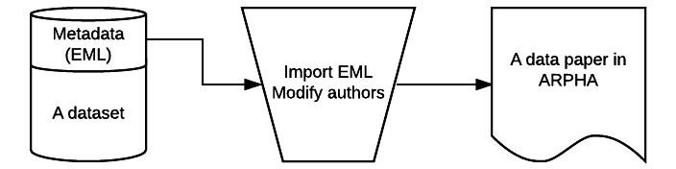

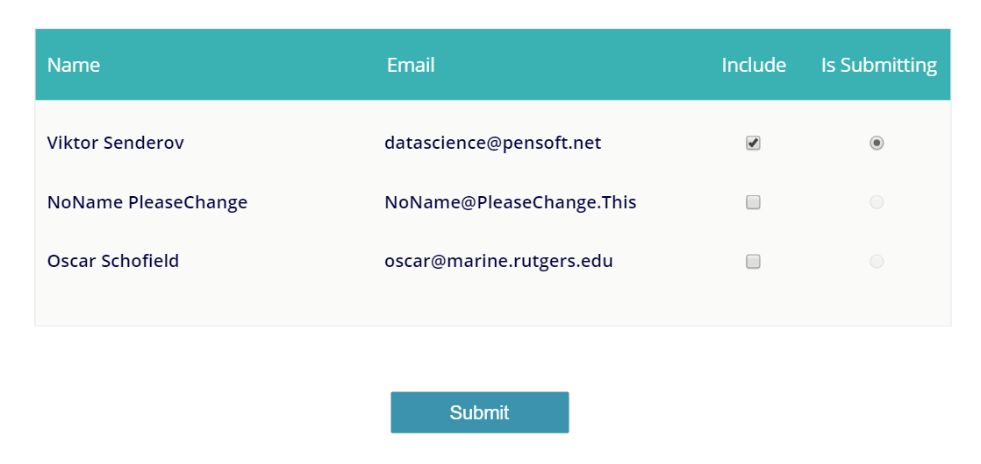
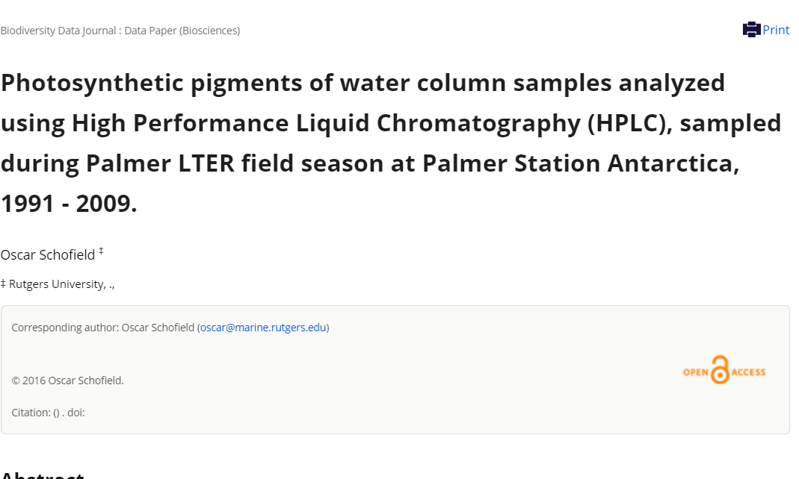


Can we generate and import an entire manuscript?

Slide 18
Live demo

Slide 19
For developers and data managers: Pensoft API
http://arpha.pensoft.net/dev/
Allows to import different types of manuscripts from XML. E.g.:
Software Description
Taxonomic Paper
Data paper
For collaborations please contact us at info@pensoft.net

Slide 20
Our sincere thanks are due to
Pensoft developers team
European Commission: EUBON FP7 Project
European Commission: PhD Financed through the EU Marie-Sklodovska-Curie Program Grant Agreement Nr. 642241
Slavena Peneva (drawings and design)

Slide 21



I Open Science!
PLAZI

